Slide 1
Cigi
Wheat Quality Research

Slide 2
GROWER ORGANIZATIONS
Cereals Canada
EXPORTER
ORGANIZATIONS
CGOEA
ITAC, WGEA
Cigi
Research
AAFC,
WGRF, CDC, GRL, Private
Crop Life Science/
Seed/ Inputs
AB Wheat Commission
SaskWheat
MB Wheat and Barley Growers Assoc’n
Regulatory
CFIA, CGC,
Health Canada
INPUT
SUPPLIERS
Seed, fertilizer, crop protection
GROWERS
HANDLERS
TRANSPORTERS
EXPORTERS
PROCESSORS
CUSTOMER
End Use products
WHEAT VALUE CHAIN

Slide 3
Cigi: Working With the Value Chain
Our Vision – Global recognition of Canadian grain and field crops as the preferred choice for end use product application.
Our Mission
To increase utilization and value opportunities for Canadian grain and field crops through:
  Superior knowledge
  Technical expertise
  Industry leadership and collaboration
  Innovative processing solutions
  Targeted training

Slide 4
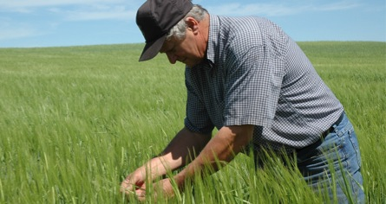
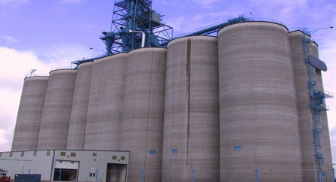
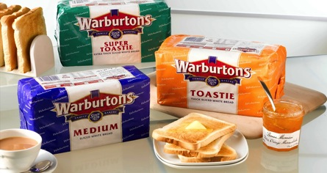
Cigi: Working With the Value Chain
Independent organization (1972)
Approximately 40 staff in Winnipeg, Manitoba; have served over 44,000 program participants
  End-use Customer technical support and training
  Combine to Customer!
  Analysis of crop attributes – analytics, milling, baking, pasta and noodle making
  Applied research on Canadian crops in end-use products (wheat, durum, pulses)
Notes:
So who is Cigi? (Speak to bullets)

Slide 5
Technical Support
Providing targeted technical support, exchanges and custom training for customers and commercial partners;
  Investigative missions – technical exchange – technical mission – new crop missions – requests for service - fee for service
  Market driven, customer focussed – millers, bakers, noodle and pasta makers, quality labs

Slide 6
Innovate/Investigate
Creating innovative solutions through analysis of crop attributes and functionality, applied research on methods and products for commercial partners;
  Applied, supports the value chain, adds value to Canadian field crops, collaborative, commercially applicable or scalable.

Slide 7
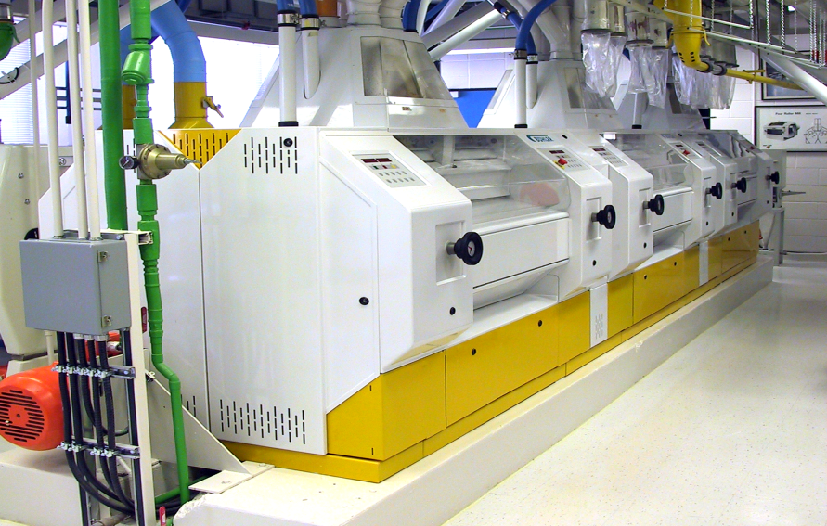
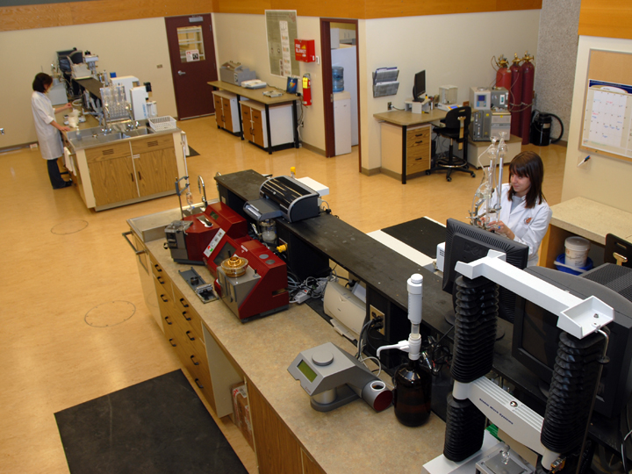
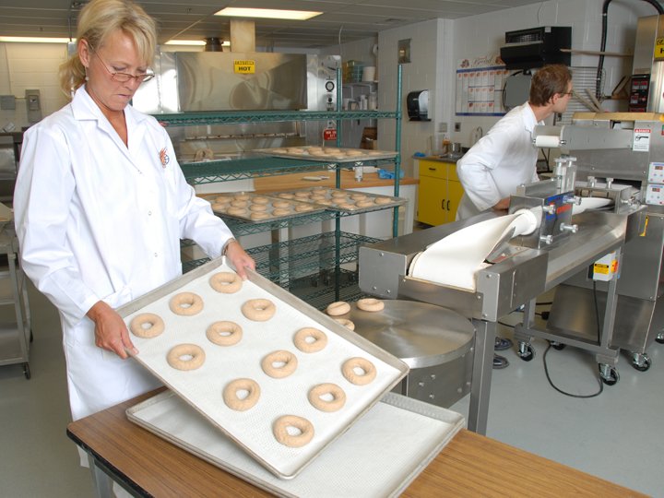
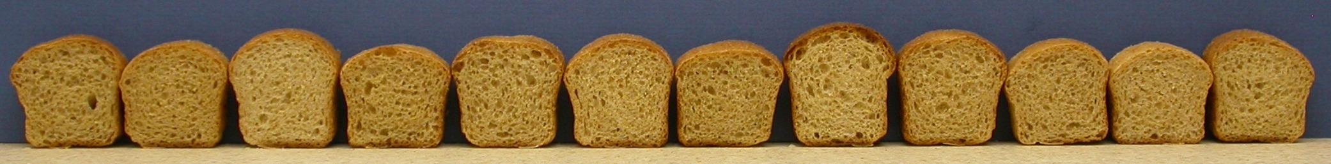
Milling, Baking, Noodles,
Asian Products, Extrusion

Slide 8
Agri Innovation Projects
Identify unique attributes of CWRS and CPSR wheat varieties
Optimization of wheat quality for milling and baking through agronomic practices
Optimization of the processing and utilization of wheat and durum affected by downgrading factors
New food applications for Canadian pulse crops

Slide 9
AIP: Varieties
Identify unique attributes of CWRS and CPSR wheat varieties
  investigate variety specific samples of CWRS and CPSR for quality characteristics
  determine if any variety offers unique characteristics that may make them more suitable for innovative food applications
  have expanded the scope to include varieties from CWAD and CWRW

Slide 10
AIP: Agronomic Practices
Optimization of wheat quality for milling and baking through agronomic practices
  investigate the effect of agronomic practices (fungicide, herbicide, nitrogen etc.) on commonly grown CWRS varieties across locations in western Canada over several crop years
  assess gluten strength of samples by milling samples into flour and completing analytical testing and test baking

Slide 11
AIP: Downgrading
Optimization of the processing and utilization of wheat and durum affected by downgrading factors
  determine the prevalent downgrading factors in a crop year and examine their effect on wheat flour/semolina and end-product quality.
  investigate innovative solutions that can be used to improve the quality of the downgraded wheat.

Slide 12
AIP: Pulses
New food applications for Canadian pulse crops
  assess end-product quality of food products made from micronized pulse flour
  mill and air classify pulses into protein-rich fractions and determine compositional and functional attributes
  assess the effects of functional ingredients on an extruded snack made from pulses
  evaluate the quality of pulses from different growing locations
  produce gluten-free baked products with pulse flours and assess end-product quality
  assess commercially available pulse flours and provide recommendations for specific food product applications

Slide 13
Internal Projects
Competitor wheats
  How does Canadian wheat compare?
Other fee-for-service projects/activities
  Opportunities for Cigi to add value
  Often confidential

Slide 14
Cigi’s Role in the Wheat Varietal Registration System in Western Canada

Slide 15
Variety Registration
Canadian Food Inspection Agency (CFIA)
Authority under Canada Seeds Act to register varieties
Authorizes recommending committees to establish science-based criteria for variety registration
CFIA and the Variety Registration office approve and issue registrations
Canadian Grain Commission (CGC)
Authority under Canada Seeds Act to assign wheat varieties to an appropriate class
Authority to deny a variety into a wheat class
Maintains variety eligibility list for each wheat class
http://www.grainscanada.gc.ca/legislation-legislation/orders-arretes/ocgcm-maccg-eng.htm

Slide 16
Variety Registration
Prairie Recommending Committees (PRC)
  Wheat, Rye & Triticale (PRCWRT) – 5 members from Cigi
  Oats & Barley (PRCOB)
  Pulses & Special Crops (PRCPSC) – 2 members from Cigi
  Oilseeds (PRCO)

Slide 17
Prairie Recommending Committee for Wheat, Rye & Triticale (PRCWRT)
Disease Evaluation Team (DET)
Pathologists
Molecular biologists
Producers
Agronomy
Evaluation Team (AET)
Breeders
Agronomists
Seed reps
Producers
Quality
Evaluation Team (QET)
Cereal Chemists
Grain Handlers
Grain Marketers
Milling/Baking reps
Each evaluation team is allowed a maximum of 25 members (Cigi has 5 staff on the QET)
Notes:
Cigi has five staff members on the QET team: Esey, Lisa, Ashok, Yvonne and Elaine

Slide 18
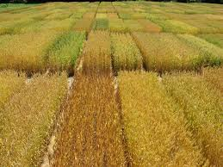
PGDC Cooperative Trials
Trials are grown at various locations
across the western prairies
Each trial may contain 30-36 entries including check varieties (2 to 5 checks)
Candidate cultivars must be equal to or better than the check varieties

Slide 19
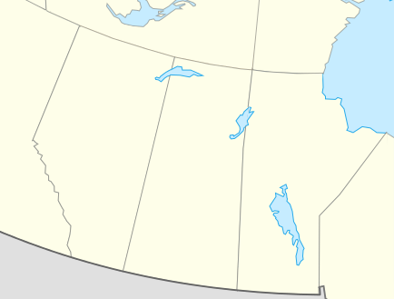
CWRS Cooperative Trials
• Parkland (12 locations)
•
•
• Western bread wheat
(13 locations)
•
• Central bread wheat
(9 locations)
•
•
•
•
•
•
•
•
•
•
•
•
•
•
•
•
•
•
•
•
•
•
•
•
British Colombia
•
•
•
•
Alberta
•
•
•
Saskatchewan
Manitoba

Slide 20
Disease Evaluation | Agronomic Evaluation
Objectives: recommend varieties with improved resistance Fusarium head blight Orange blossom wheat midge (midge) Rusts (leaf/stem/stripe) Common bunt Loose smut Leaf spots | Objectives: recommend varieties with improved agronomic properties Increased grain yield Increased test weight (TW) Appropriate maturity Lodging resistance Shorter straw Pre-harvest sprout resistance Winter hardiness (for CWRW) Decreased cadmium uptake (CWAD; < 100 ppb)

Slide 21
Quality Evaluation Team
Objectives: recommend varieties with improved milling and end-product characteristics to meet or improve upon class specifications
  Protein (quantity and quality (farinograph & extensograph))
  Milling yield
  Falling number and Amylograph
  Flour/semolina ash
  Starch damage
  End-product quality (bread, Asian noodles, pasta, cookies)
Notes:
Cigi has been involved in doing quality evaluation for private breeders.

Slide 22
PGDC Process
Meetings held every February
Each evaluation team (AET, DET, QET) reviews trial data for the candidate cultivars and votes
  Support, Do Not Object, Object, Abstain
3rd year lines receiving support for registration can be registered by the Breeder through the Variety Registration Office (VRO) of CFIA

Slide 23
Cigi Involvement in Variety Registration
Interactions with domestic and international customers provides Cigi staff with increased technical knowledge that helps guide quality recommendations and ensures customers needs are brought to the discussions.
Cigi has conducted early generation screening of varieties for AAFC and private breeders.
Cigi continues to conduct testing for candidate cultivars for registration for private breeders.
Notes:
WRT QET = Wheat, Rye and Triticale Quality Evaluation Team
Cigi’s knowledge of the commercial use of wheat (and the end products the flour is used for) is an important piece for consideration of class quality. A single class could be used in many different products and markets and having the knowledge of this use is essential in establishing class quality parameters.

